Slide 1
K- Nearest Neighbours (KNN)

Slide 2
Learning Objectives
Introduction to KNN
Euclidian Distance
Determine K neighbours
Approach to find Nearest Neighbours
Pros and Cons of KNN
Hands on exercise on KNN
Interview Questions
Case Study
2

Slide 3
Nearest Neighbor Classification
The Nearest Neighbors are defined by their characteristics of class and using them to classify the unlabeled set of data
Suitable for Classification Tasks where the relationship between features and target class are numerous, complex and extremely difficult to understand.
Computer Vision Applications
Optical Character Recognition
Predicting if a person will enjoy music or a movie based on recommendations
Patterns in Genetic Data
Detecting Diseases

Slide 4
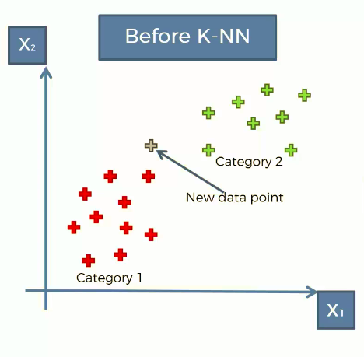
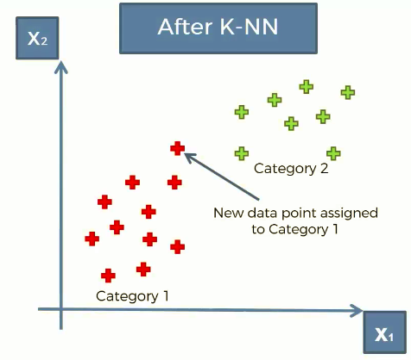
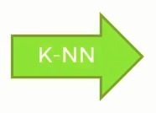
What k-NN does
Whether a new point should be
Classified as Red Point or Green Point, This is where k-NN comes.

Slide 5
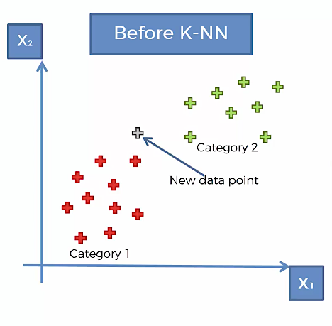
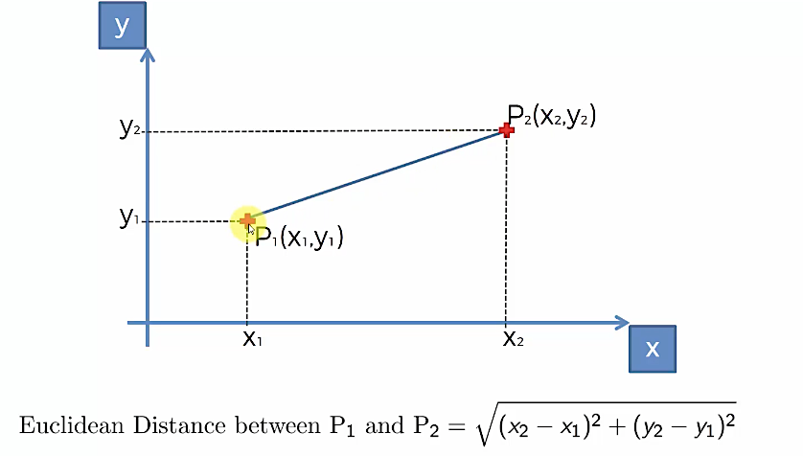
Euclidean Distance
Default Value of ‘K’ is 05

Slide 6
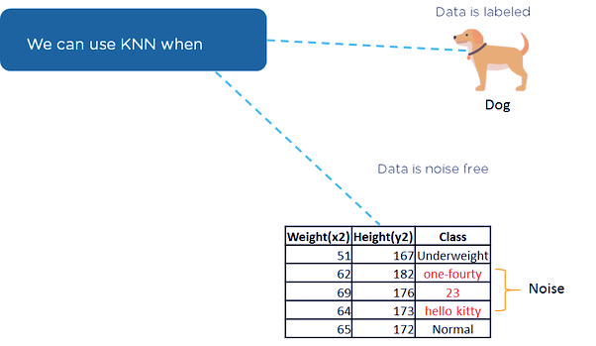

Slide 7
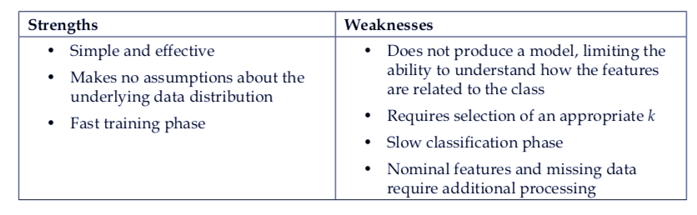
k-NN Ground Realities

Slide 8
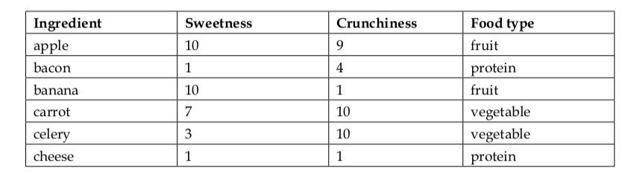
Blind Taste Experience
Blind Taste Experience involves some people going in a restaurant and tasting food in darkness.
In Mystery Meal, people are asked to mark the food on two parameters – Crunchy and Sweet
Scale used – 1 to 10 (10 being highest and 01 being lowest)
The food products are labeled as follows:

Slide 9
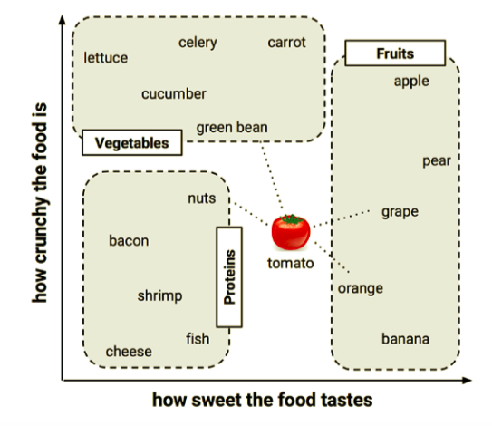
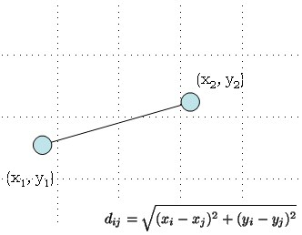
Tomato Family
Notice the pattern of Veggies, Fruits and Proteins
Locating the tomato’s nearest neighbor requires a distance formula.
k-NN uses EUCLIDEAN DISTANCE to find the answer

Slide 10
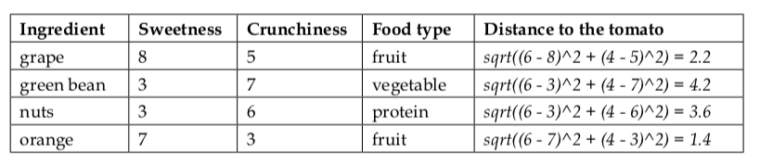
This is an example of 1-NN

Slide 11
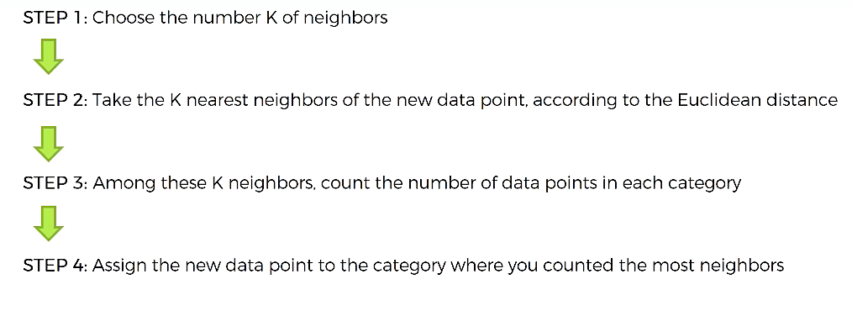
How does it work??

Slide 12
Thus, KNN is….
It is an instance-based method for predicting class or value of a given query.
Classification is computed from a simple majority vote of the nearest neighbours of each point.
Not suited if the data is noisy and the target classes do not have clear demarcation in terms of attribute values.
The approach to find the nearest neighbour using distance between the query point and the other points is called Brute Force.
To ensure all the dimensions have similar scale, we normalize the data on all the dimensions/ attributes.
There are multiple ways of normalizing the data. We will use Z-score standardization.

Slide 13
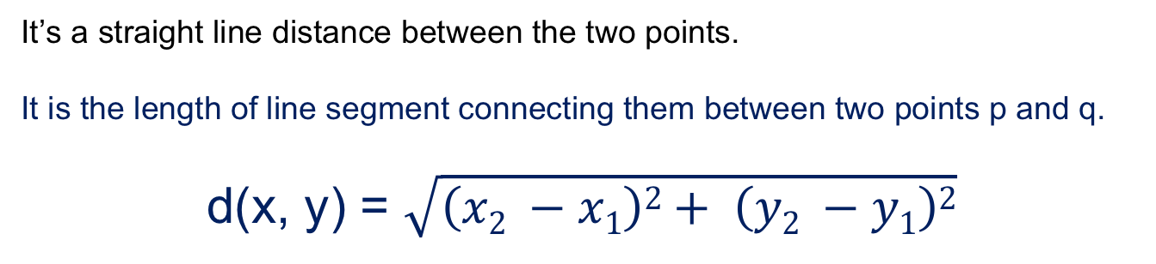
Euclidean Distance
It’s a straight line distance between the two points.
It is the length of line segment connecting them between two points p and q.
d(x, y) = $\sqrt{\left(x2 −x1\right)2+ \left(y2 −y1\right)2}$
For points (x1,y1,z1 (x2,y2,z2) in 3-dimensional space, the Euclidean distance between them would be
d(x, y) = $\sqrt{\left(x2 −x1\right)2+ \left(y2 −y1\right)2+ \left(z2 −z1\right)2}$
Find the Euclidean Distance between the points
(-1,2,3) and (4,0,-3)
Which of the following will be Euclidean Distance between the two data point A(1,3) and B(2,3)?
Why Euclidean Distance is used?
The Euclidean Distance tool is used frequently as a stand-alone tool for applications, such as finding the nearest hospital for an emergency helicopter flight. Alternatively, this tool can be used when creating a suitability map, when data representing the distance from a certain object is needed.

Slide 14
Determine K neighbours
Scikit-learn implements two different nearest neighbours classifiers – K Nearest Neighbour Classifier and Radius Neighbour Classifier.
Radius Neighbour Classifier implements learning based on number of neighbours within a fixed radius r of each training point.
Determining the optimal K is a challenge. In general, larger value of K suppresses impact of noise but prone to majority class dominating.

Slide 15
Pros and Cons of KNN
Advantages
Not impacted by Outliers
Makes no assumptions about distributions of classes in feature space
Disadvantages
Fixing the optimal value of K is a challenge
Does not output any models. Calculates distances for every new point

Slide 16
Interview Questions
1. In the image below, which would be the best value for k assuming that the algorithm you are using is k-Nearest Neighbour.
A) 3 B) 10 C) 20 D) 50

Slide 17
Interview Questions
1. In the image below, which would be the best value for k assuming that the algorithm you are using is k-Nearest Neighbour.
A) 3 B) 10 C) 20 D) 50
Solution: B
Validation error is the least when the value of k is 10. So it is best to use this value of k

Slide 18
Interview Questions
2. Which of the following distance metric can not be used in k-NN?
A) Manhattan B) Minkowski C) Tanimoto D) Jaccard E) Mahalanobis F) All can be used

Slide 19
Interview Questions
2. Which of the following distance metric can not be used in k-NN?
A) Manhattan B) Minkowski C) Tanimoto D) Jaccard E) Mahalanobis F) All can be used
Solution: F
All of these distance metric can be used as a distance metric for k-NN.

Slide 20
Interview Questions
3. Which of the following option is true about k-NN algorithm?
A) It can be used for classification B) It can be used for regression C) It can be used in both classification and regression

Slide 21
Interview Questions
3. Which of the following option is true about k-NN algorithm?
A) It can be used for classification B) It can be used for regression C) It can be used in both classification and regression
Solution: C
We can also use k-NN for regression problems. In this case the prediction can be based on the mean or the median of the k-most similar instances.

Slide 22
Interview Questions
4. Which of the following machine learning algorithm can be used for imputing missing values of both categorical and continuous variables?
A) K-NN B) Linear Regression C) Logistic Regression

Slide 23
Interview Questions
4. Which of the following machine learning algorithm can be used for imputing missing values of both categorical and continuous variables?
A) K-NN B) Linear Regression C) Logistic Regression
Solution: A
k-NN algorithm can be used for imputing missing value of both categorical & continuous variables.

Slide 24
Interview Questions
5. Which of the following distance measure do we use in case of categorical variables in k-NN?
Hamming Distance
Euclidean Distance
Manhattan Distance

Slide 25
Interview Questions
5. Which of the following distance measure do we use in case of categorical variables in k-NN?
Hamming Distance
Euclidean Distance
Manhattan Distance
Answer 1:
Both Euclidean and Manhattan distances are used in case of continuous variables, whereas hamming distance is used in case of categorical variable.

Slide 26
Interview Questions
6. A company has build a KNN classifier that gets 100% accuracy on training data. When they deployed this model on client side it has been found that the model is not at all accurate. Which of the following thing might gone wrong?
Note: Model has successfully deployed and no technical issues are found at client side except the model performance A) It is probably a overfitted model B) It is probably a underfitted model C) Can’t say D) None of these

Slide 27
Interview Questions
6. A company has build a KNN classifier that gets 100% accuracy on training data. When they deployed this model on client side it has been found that the model is not at all accurate. Which of the following thing might gone wrong?
Note: Model has successfully deployed and no technical issues are found at client side except the model performance A) It is probably a overfitted model B) It is probably a underfitted model C) Can’t say D) None of these
Solution A:
In an overfitted module, it seems to be performing well on training data, but it is not generalized enough to give the same results on a new data.

Slide 28
Hands on exercise on KNN
The dataset used here is Breast Cancer Wisconsin data (https://www.kaggle.com/uciml/breast-cancer-wisconsin-data)
Some important functions
1. Importing Libraries
import pandas as pd
import seaborn as sns
import numpy as np
2. Assigning Kneighbour
NNH = KNeighborsClassifier(n_neighbors= 5 , weights = 'distance' )

Slide 29
3. Recognise the data types of each variables
bc_df['diagnosis'] = bc_df.diagnosis.astype('category')
bc_df.dtypes
4. Summary of the dataset
bc_df.describe().transpose()
5. Create a separate dataframe consisting only of the features i.e independent attributes
bc_feature_df = bc_df.drop(labels= "diagnosis" , axis = 1)
bc_feature_df.head()

Slide 30
6. Split X and y into training and test set in 75:25 ratio
X_train, X_test, y_train, y_test = train_test_split(X, y, test_size=0.30, random_state=1)
7. Call Nearest Neighbour algorithm
NNH.fit(X_train, y_train)
8. For every test data point, predict it's label based on 5 nearest neighbours in this model. The majority class will be assigned to the test data point
predicted_labels = NNH.predict(X_test)
NNH.score(X_test, y_test)

Slide 31
Case Study
Context:
The dataset to be audited was provided which consists of a wide variety of intrusions simulated in a military network environment It created an environment to acquire raw TCP/IP dump data for a network by simulating a typical US Air Force LAN. The LAN was focused like a real environment and blasted with multiple attacks. For each TCP/IP connection, 41 quantitative and qualitative features are obtained from normal and attack data (3 qualitative and 38 quantitative features) .
The class variable has two categories:
• Normal
• Anomalous

Slide 32
Dataset Info
Dataset:
https://www.kaggle.com/what0919/intrusion-detection
Data basically represents the packet data for a time duration of 2 seconds.
1-9 Columns: basic features of packet (type 1)
10-22 columns: employ the content features (type 2)
23-31 columns: employ the traffic features with 2 seconds of time window (type 4)
32-41 columns: employ the host based features

Slide 33
Objective and Steps
To detect Network Intrusion using KNN
Steps:
Import Libraries and Data
Data Preparation and analysis(standardization)
Split the dataset into training and test datasets
Build the model and train and test on training and test sets respectively using scikit-learn. Print the Accuracy of the model with different values of k=3,5,9

Slide 34


Questions?

